Slide 1
COS 212 Binary Trees: Balancing a Tree

Slide 2
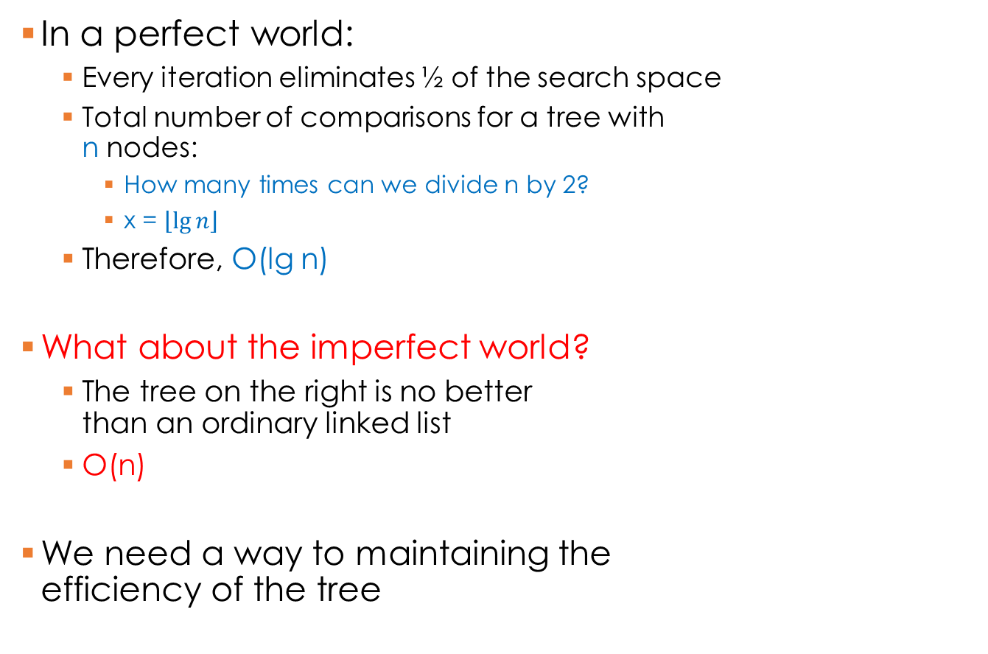
Binary Search Trees
5
In a perfect world:
Every iteration eliminates ½ of the search space
Total number of comparisons for a tree with n nodes:
How many times can we divide n by 2?
x = $\left\lfloor \lg{n}\right\rfloor$
Therefore, O(lg n)
What about the imperfect world?
The tree on the right is no better than an ordinary linked list
O(n)
We need a way to maintaining the efficiency of the tree
3
7
1
6
9
A
D
E
F
Z

Slide 3
Binary Search Trees
What makes a tree efficient?
We want to eliminate about ½ of the search space every time we go down a branch
Thus, the height of left and right branches of all nodes should be more or less the same height
Allow max difference between branch height = 1
A
3
D
5
1
7
E
10
3
7
2
6
F
5
1
6
9
Z

Slide 4
Balanced Binary Search Trees
A BST is height-balanced if the difference in height of both sub-trees of all nodes is either zero or one
A BST is perfectly balanced if it is balanced and all leaves are on one, max two levels
M
A
5
G
P
D
3
7
C
H
O
Q
E
1
6
9
B
D
J
N
F
A
Z

Slide 5
Balanced Binary Search Trees
How do we balance a tree?
Order of insertion matters:
A D E F Z
E A D F Z
A
E
D
A
F
E
D
Z
F
Z

Slide 6
Balanced Binary Search Trees
Sort the data
Find the middle
Insert the middle element
Repeat (2) on the left half
Repeat (2) on the right half
Problem?
An external data structure is necessary
Sorting is necessary
Must we do this every time an item is inserted?
A D E F Z
E
A
F
D
Z

Slide 7
DSW Algorithm
Day–Stout–Warren (DSW) algorithm: a method for efficiently balancing BSTs without an additional data structure
What it does: converts an arbitrary BST into a perfectly balanced BST
How: by a series of tree rotations
What is a tree rotation?

Slide 8
Rotations
A single rotation swaps the roles of a child node and a parent node without breaking the BST relationship
Two types of rotations:
Left rotation: parent becomes the left child of its right child (i.e., parent moves to the left)
Right rotation: parent becomes the right child of its left child (i.e., parent moves to the right)
D
Right rotation of child A about parent D
A
E
E
A
Left rotation of child E about parent D
D
D
A
E

Slide 9
Rotations
G
?
What if the child nodes rotated are not leaf nodes?
Right rotation algorithm:
Parent becomes right child of its left child
Left child’s right branch becomes the old parent’s left branch (Example: C < D < G: D can be right of C or left of G )
C
H
B
D
J
C
G
B
G
C
H
D
H
B
D
J
J

Slide 10
Right Rotation: Step-by-step
Note: These are not values!
G = Grandparent
P = Parent
C = Child
G
G
G
P
P
P
C
C
C
Z
Z
Z
X
Y
X
Y
X
Y
1. Grandparent G of child C becomes C’s parent by replacing P
2. Right subtree of C becomes left subtree of C’s parent P
G
G
P
C
C
==
X
P
Z
X
Y
Y
Z
3. Node C acquires P as its right child

Slide 11
Left Rotation
Simply the opposite of a right rotation
Right rotation algorithm:
Parent becomes right child of its left child
Left child’s right branch becomes parent’s left branch
Left rotation algorithm:
Parent becomes left child of its right child
Right child’s left branch becomes parent’s right branch

Slide 12
Left Rotation
Note:
G = Grandparent
P = Parent
C = Child
These are not values!
G
G
P
C
C
P
X
Z
Y
Z
X
Y
C
G
Rotate Left around C
B
G
C
H
D
H
B
D

Slide 13
DSW Algorithm
Day–Stout–Warren (DSW) algorithm: a method for efficiently balancing BSTs without an additional data structure
Basic idea:
Linearize the tree into a single right branch, or backbone
Perform a series of left rotations on the linearized tree to make it perfectly balanced
Creating a backbone:
createBackbone()
tmp = root;
while tmp ≠ null
if tmp has a left child
right rotate this child about tmp;// left child becomes
right rotate this child about all;// parent of tmp;
set tmp to the child which just became parent;
else set tmp to its right child;

Slide 14
Creating a backbone
10
5
5
5
15
10
10
20
15
15
16
30
20
16
17
16
30
20
18
17
17
30
18
18

Slide 15
Creating a backbone
5
5
5
10
10
10
15
15
15
16
16
16
20
17
17
17
30
20
18
18
18
30
20
30

Slide 16
DSW Algorithm
Now that we have a backbone:
We need to convert the backbone into a perfectly balanced tree
Remember, a perfectly balanced tree
Is height balanced
Has leaf nodes on a maximum of two levels
To do this, we need to figure out how many left rotations are required
Left rotations are based on
The number of nodes in the backbone
The number of nodes making up a full tree of the required size
Possibly some “overflow” nodes

Slide 17

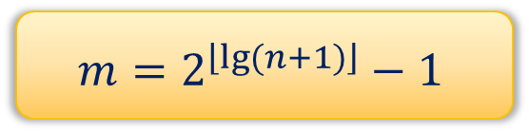






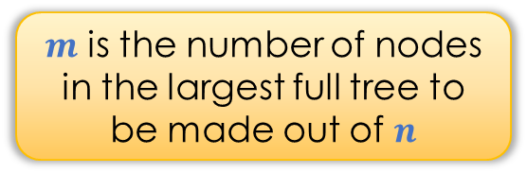
DSW Algorithm
Start with a backbone
The backbone has $n$ nodes
How many levels will a resulting perfectly balanced tree have?
$n=2^{h}−1$
$2^{h}=n+1$
$h=lg⁡(n+1)$
Assumption: $n$ “fills” a perfect tree
What if n = 8?
Level: 1, # nodes: $2^{0}$ = 1
Tree height $h=3$
Number of nodes?
7
= $2^{3} −1$
Level: 2, # nodes: $2^{1}$ = 2
Given $n$, what is $h$?
Level: 3, # nodes: $2^{2}$ = 4
$$m=2^{\left\lfloor lg(n+1)\right\rfloor }−1$$
$m$ is the number of nodes in the largest full tree to be made out of $n$

Slide 18
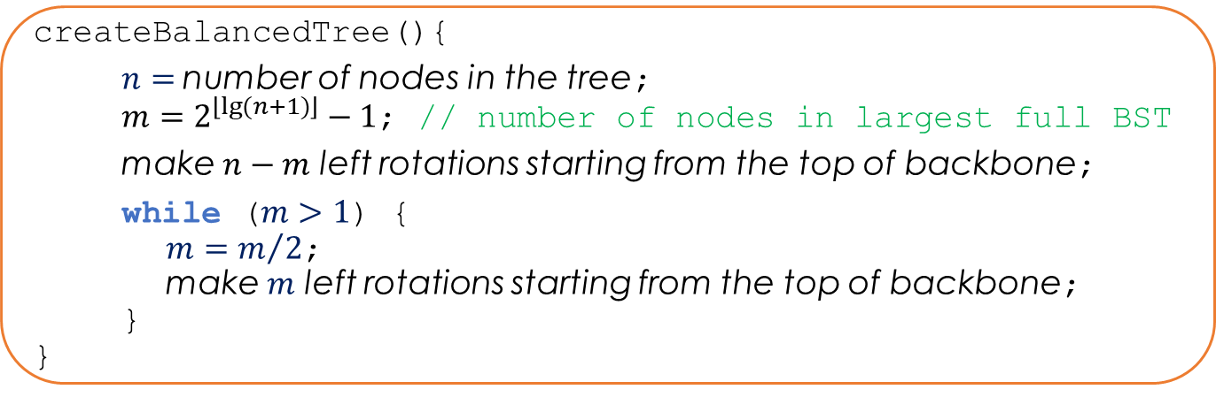
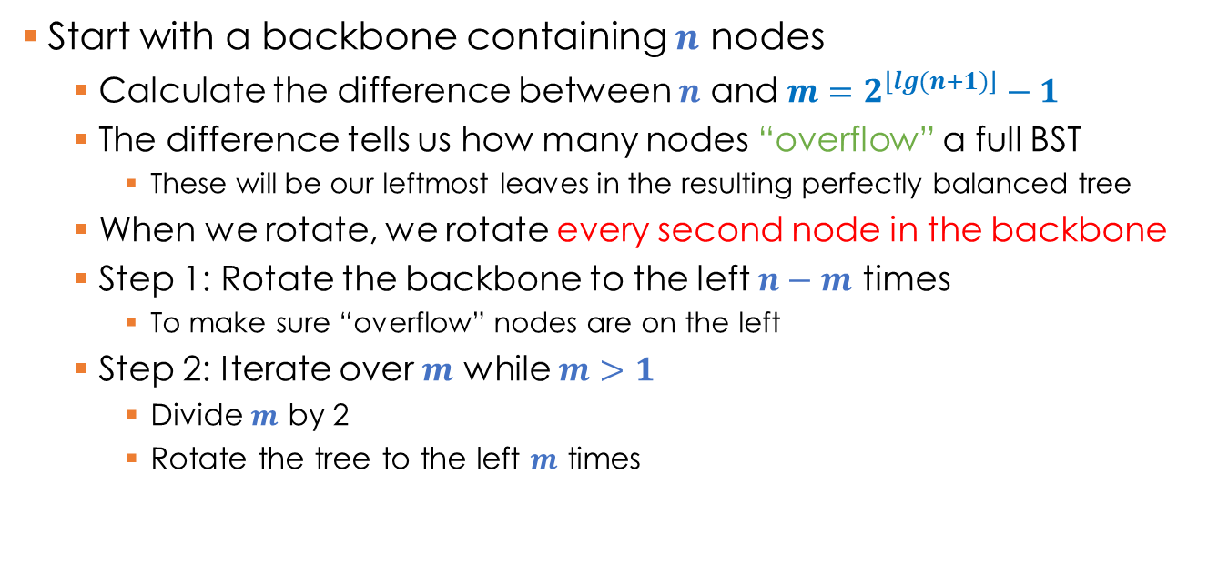
DSW Algorithm
Start with a backbone containing $n$ nodes
Calculate the difference between $n$ and $m=2^{\left\lfloor lg(n+1)\right\rfloor }−1$
The difference tells us how many nodes “overflow” a full BST
These will be our leftmost leaves in the resulting perfectly balanced tree
When we rotate, we rotate every second node in the backbone
Step 1: Rotate the backbone to the left $n−m$ times
To make sure “overflow” nodes are on the left
Step 2: Iterate over $m$ while $m>1$
Divide $m$ by 2
Rotate the tree to the left $m$ times
createBalancedTree(){
$n=$number of nodes in the tree;
$m=2^{\left\lfloor lg(n+1)\right\rfloor }−1$; // number of nodes in largest full BST
make $n−m$ left rotations starting from the top of backbone;
while ($m>1$) {
$m=m/2$;
make $m$ left rotations starting from the top of backbone;
}
}

Slide 19
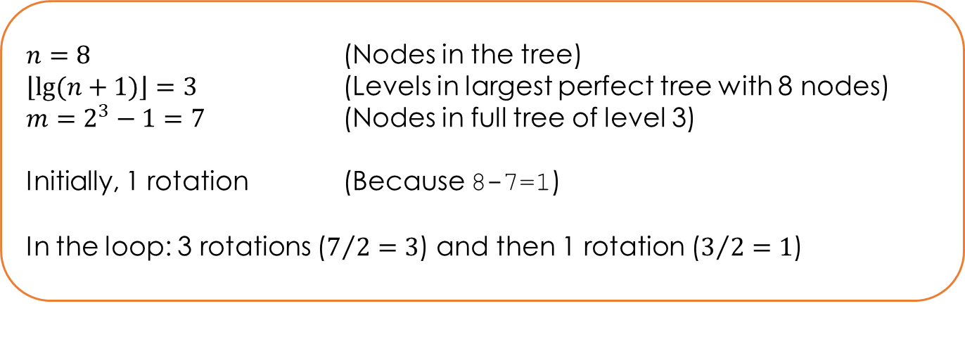

DSW Algorithm
createBalancedTree(){
$n=$number of nodes in the tree;
$m=2^{\left\lfloor lg(n+1)\right\rfloor }−1$; // number of nodes in largest full BST
make $n−m$ left rotations starting from the top of backbone;
while ($m>1$) {
$m=m/2$;
make $m$ left rotations starting from the top of backbone;
}
}
$n=8$ (Nodes in the tree)
$\left\lfloor lg(n+1)\right\rfloor =3$ (Levels in largest perfect tree with 8 nodes)
$m=2^{3}−1=7$ (Nodes in full tree of level 3)
Initially, 1 rotation (Because 8-7=1)
In the loop: 3 rotations ($7/2=3$) and then 1 rotation ($3/2=1$)

Slide 20
DSW Algorithm: Creating Balanced BST
5
10
15
10
5
15
10
17
15
16
5
16
20
16
17
18
30
17
18
17
18
20
15
20
20
30
10
16
18
30
30
5

